Slide 1
No Taxpayer Funding for Abortion and Abortion Insurance Full Disclosure Act of 2017
Diana Feldmaier-Paarmann

Slide 2
Quick summary
TITLE I--PROHIBITING FEDERALLY FUNDED ABORTIONS
(Sec. 101) This bill makes permanent the prohibition on the use of federal funds, including funds in the budget of the District of Columbia, for abortion or health coverage that includes abortion. The prohibitions in this bill, and current prohibitions, do not apply to abortions in cases of rape or incest, or where a physical condition endangers a woman's life unless an abortion is performed.
Abortions may not be provided in a federal health care facility or by a federal employee.
TITLE II--APPLICATION UNDER THE AFFORDABLE CARE ACT
(Sec. 201) This bill amends the Internal Revenue Code and the Patient Protection and Affordable Care Act to prohibit qualified health plans from including coverage for abortions. (Qualified health plans are sold on health insurance exchanges, are the only plans eligible for premium subsidies and small employer health insurance tax credits, and fulfill an individual's requirement to maintain minimum essential coverage.) Currently, qualified health plans may cover abortion, but the portion of the premium attributable to abortion coverage is not eligible for subsidies.
(Sec. 202) The bill revises notification requirements for qualified health plans regarding abortion coverage and charges for abortion coverage.

Slide 3
problem
Majority of women seeking abortion are lower SES
  Pushing healthcare further out of reach affects their future economic status
Majority of women seeking abortion are also women of color
  Disproportionally affected by poverty/not able to afford the cost of abortion
Women turn to unsafe abortions
Abortions are a component of comprehensive healthcare that everyone should be entitled to

Slide 4
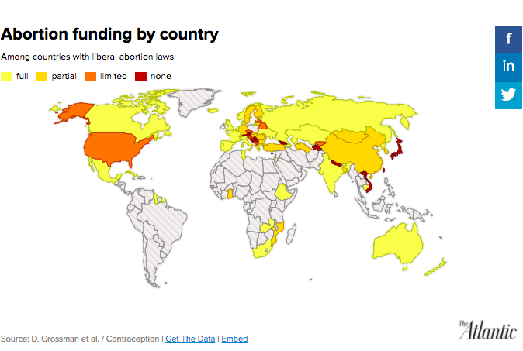
Ibis and Advancing New Standards in Reproductive Health (ANSIRH) at the University of California San Francisco (UCSF)2016 study of 80 countries with liberal or liberally interpreted abortion laws
34 of the countries provided full government funding
25 provided “partial” support: funds only for poor women or in public clinics.

Slide 5
Role of social work
Social work's commitment to promote the human rights of women
Policies that disproportionally discriminate against young women, low-income women, and women of color

Slide 6
NASW Code of ethics
Ethical Principle: Social workers respect the inherent dignity and worth of the person.
  clients need to make decisions about their own lives (self-determination)
Current federal policies lack assurance of adequate funding for family planning services
  obstacle for women who want to exercise their reproductive rights
Ethical Principle: Social workers challenge social injustice
  ensure access to needed information, services, and resources; equality of opportunity

